Slide 1

Bandwidth-Aware Federated Learning with CI-Enhanced Edge Computing
Team: 33_No_Internet
Members:
CB.SC.U4CSE23659 – M Anusree
CB.SC.U4CSE23565 – Siddharth Ladda
CB.EN.U4ELC23057 – Vidhyarth
CB.EN.U4ELC23051 – Syed Faazil S
CB.SC.U4CSE23152 – Vinaayak Kanagaraj
CB.SC.U4CSE23760 – Hemanth Kumar G T

Slide 2

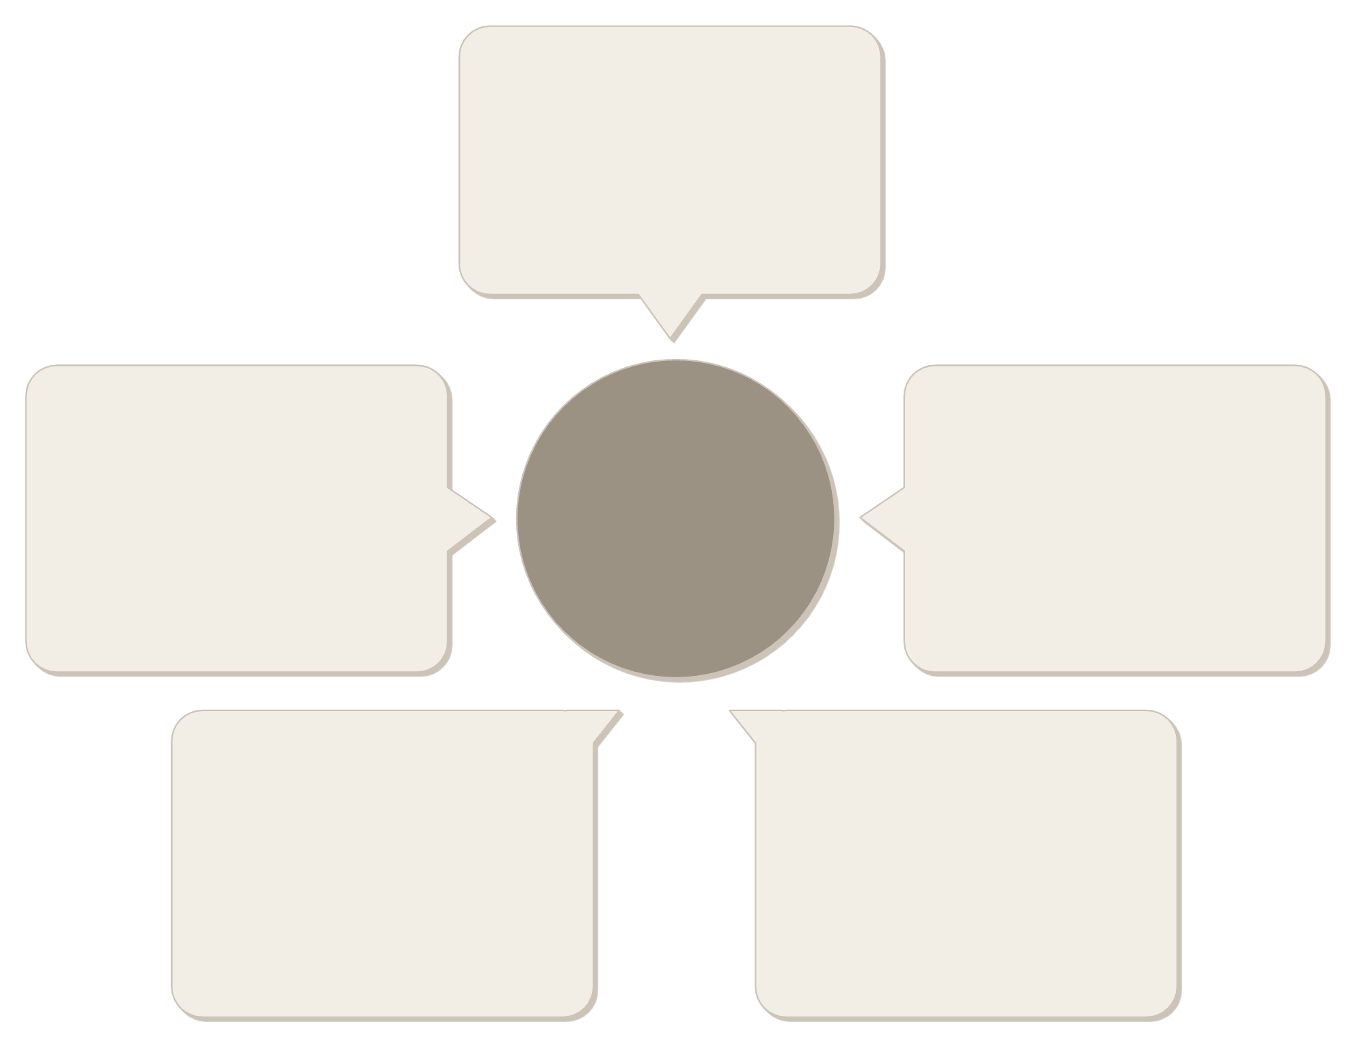
Bandwidth-Aware Federated Learning with CI-Enhanced Edge Computing
Edge Computing X CI Team
Real-time analytics
Low-latency data insights
CI collaboration
Edge Computing x CI Team
Distributed sensors
Cross-functional workflows
Edge device telemetry
Secure connectivity
Model deployment
Encrypted data channels
On-device AI models
Engineering a robust federated learning system combining edge computing and computational intelligence, delivering security through Byzantine Fault Tolerance and optimization via Particle Swarm Optimization for scalable and trustworthy Model Updates.

Slide 3

Updates From Review-1
Enhanced Compression
Dataset Optimization
CI Layer Integration
Added Top-k sparsification with adaptive bandwidth-aware compression (rₜ = Bandwidth × Time / Full Update Size)
Fixed MNIST partitioning for 70,000 images, 28×28 pixels each
Incorporated BFT and PSO for dual-layer screening and optimization
Performance Achievement: 80% accuracy in malicious actor detection via BFT

Slide 4
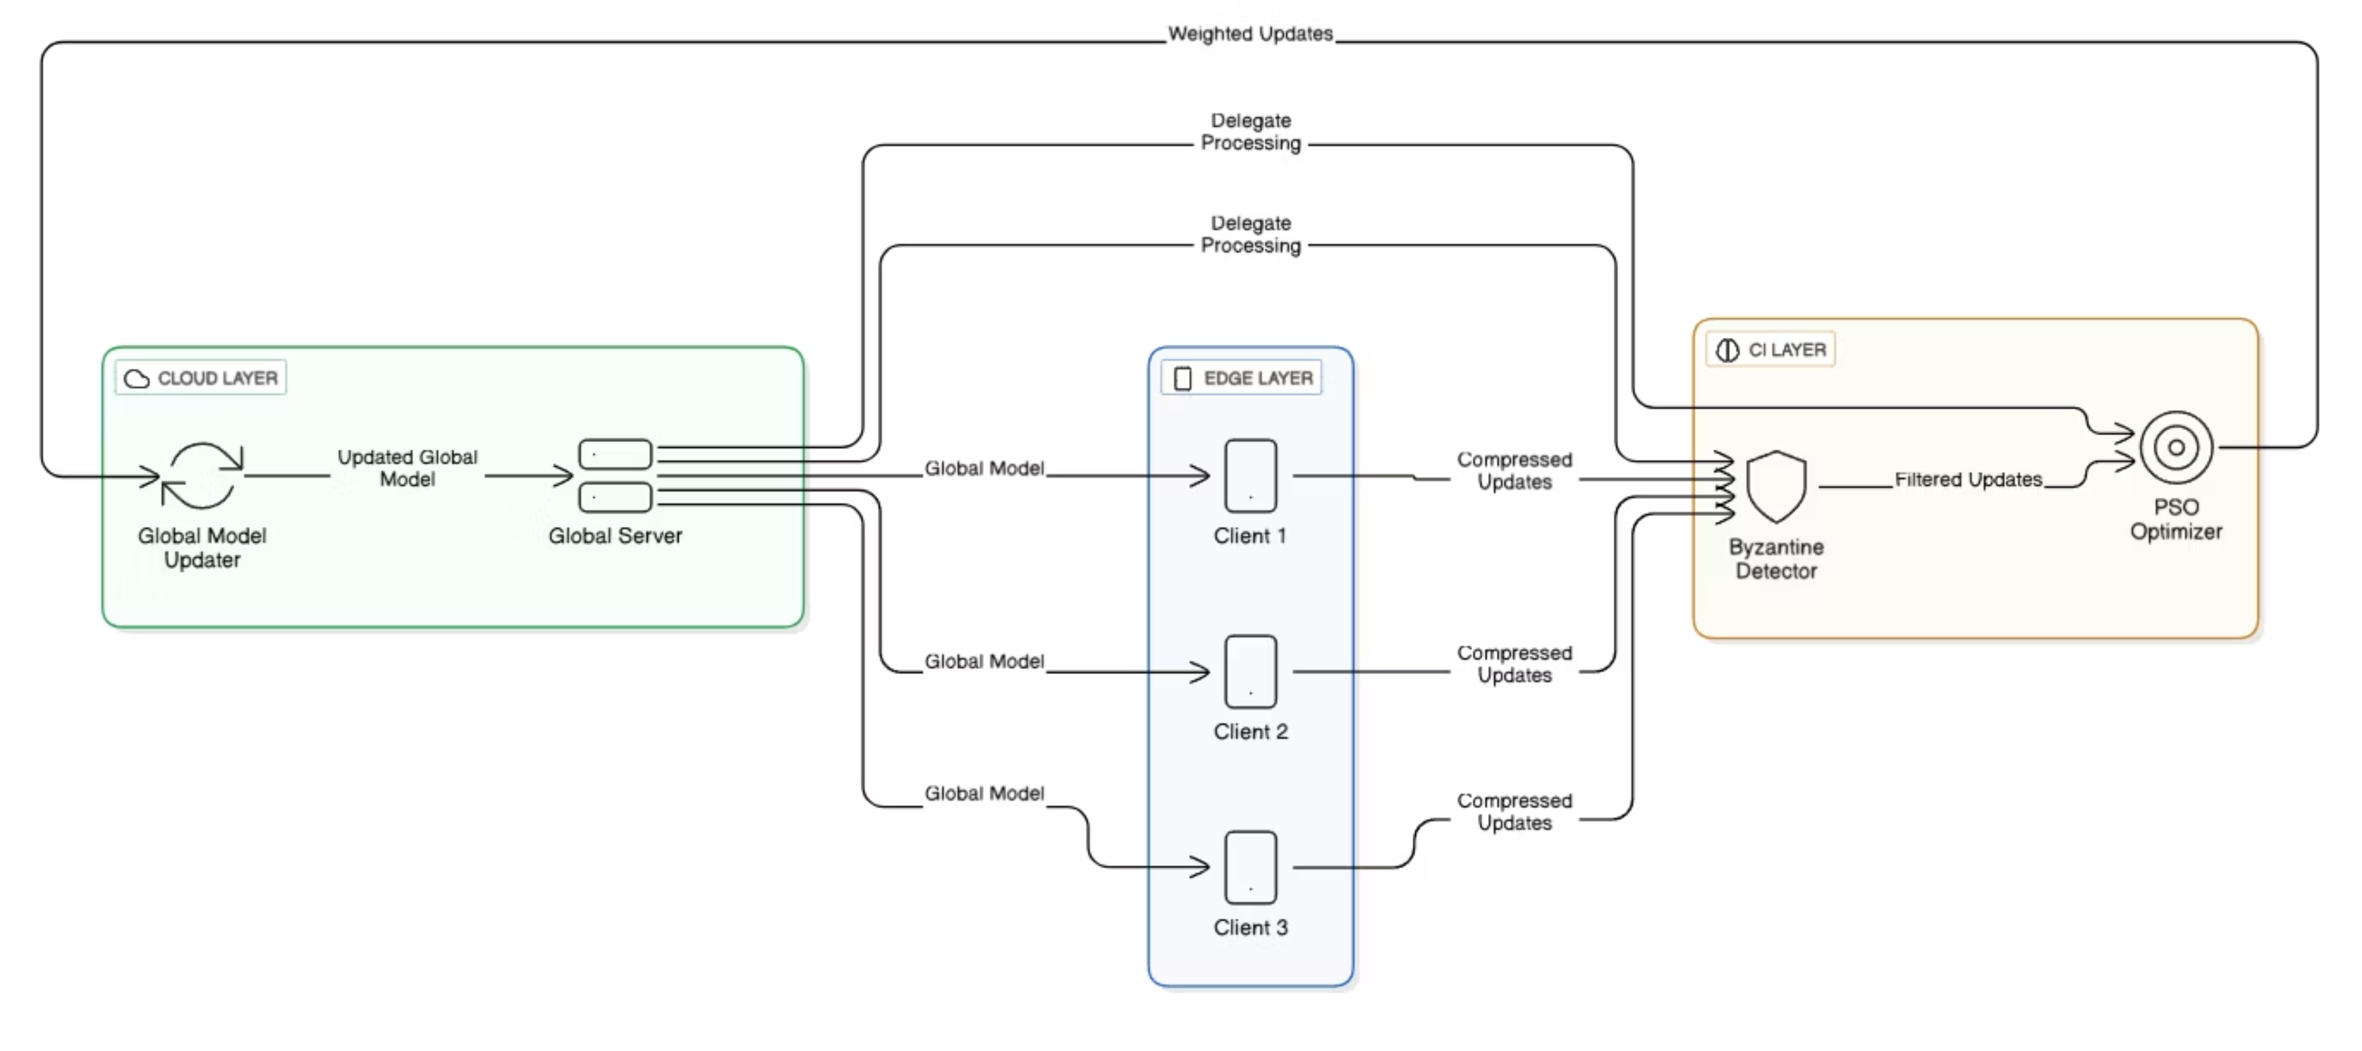

System Architecture
CNN Model Specs: 421,642 parameters across conv1 (320), conv2 (18,496), fc1 (401,536), fc2 (1,290)

Slide 5
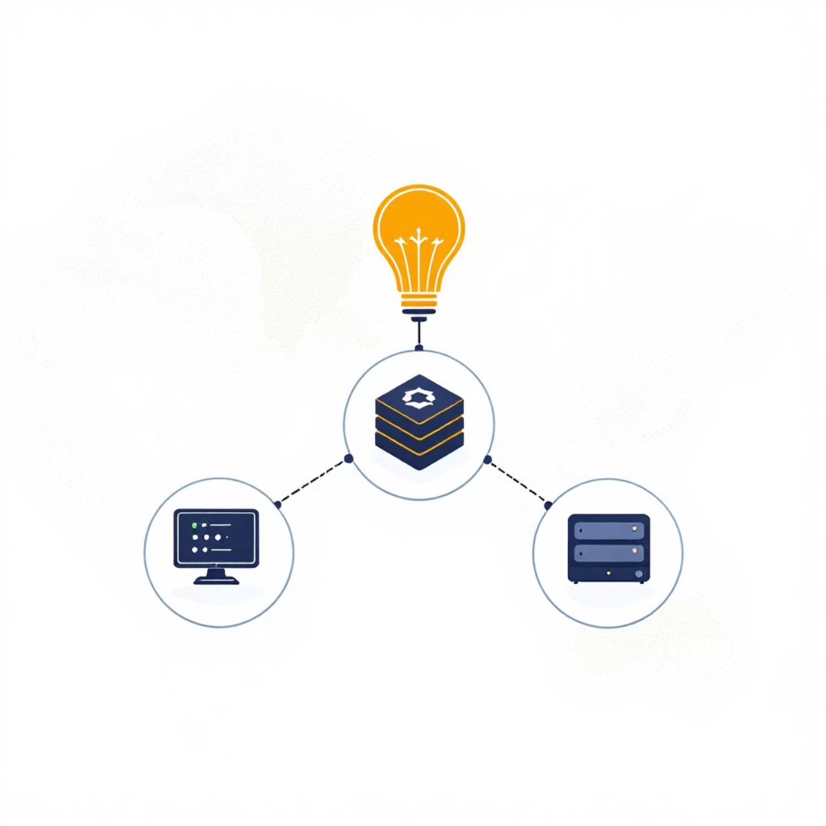
Communication & Edge Node Setup
Local Simulation Protocol
All communication in-memory via Python (no HTTP/network)
Three clients: client0, client1, client2
Bandwidth varied randomly per cycle
Smart scheduling skips updates below 5% threshold
Compression Formula:rt = (Simulated Bandwidth × Time) / Full Update Size

Slide 6

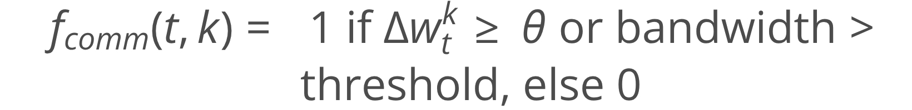
Algorithms Implemented
FedAvg (Federated Averaging)
ACFL (Adaptive Communication Federated Learning)
Aggregation algorithm where the server updates the global model by taking a weighted average of client updates, proportional to their dataset sizes.
Adaptive algorithm that reduces communication cost by letting clients dynamically decide whether to send updates or adjust compression based on bandwidth and update importance.

Slide 7






Core Functionalities Implemented
client.py
compression.py
Simulates bandwidth, trains CNN, applies Top-k compression for efficient data transmission
Implements Top-k sparsification logic for bandwidth-aware model updates
server.py
bft_strategy.py
Aggregates updates and verifies global model integrity via SHA-256 hashes
Byzantine Fault Tolerance algorithm eliminates up to 80% outliers/malicious clients
pso_optimizer.py
simulator.py
Particle Swarm Optimization for multi-criteria client selection balancing accuracy and performance
Master orchestrator managing all training, screening, and aggregation rounds

Slide 8
Implementation & Development Timeline
Initial Setup
1
Basic federated framework with MNIST partitioning implementation
2
Compression Integration
Added adaptive Top-k compression and bandwidth simulation capabilities
BFT Security Layer
3
Trusted dataset-based candidate screening achieving 80% malicious client detection
4
PSO Enhancement
Fitness score client selection balancing multiple performance metrics
Simulator Completion
5
Full orchestration through simulator.py managing all training logic

Slide 9
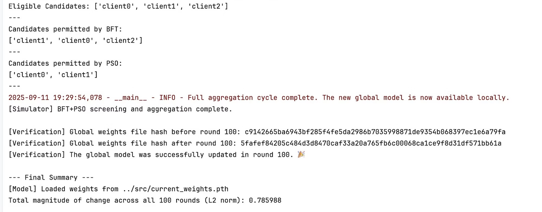
SIMULATION OUTPUT

Slide 10

Simulation Results & Performance
100
80%
0.786
Training Rounds
Detection Accuracy
Final L2 Norm
Complete cycles in 25 minutes
Malicious actor identification via BFT
Stable incremental learning achieved
Time Complexity: T = R × (L + C + S + A) where R = rounds, L = local computation, C = compression, S = screening, A = aggregation
Global model successfully updated with verified hash integrity across all rounds.

Slide 11

CI Integration Benefits & Future Directions
Current CI Benefits
Fault Tolerance
BFT detects and removes malicious clients ensuring system robustness
Swarm Intelligence
PSO avoids local optima, improving overall model quality through intelligent client selection
Impact: Hybrid BFT+PSO outperforms classical distance-based methods, providing evolutionary optimization for federated learning in edge environments.

Slide 12
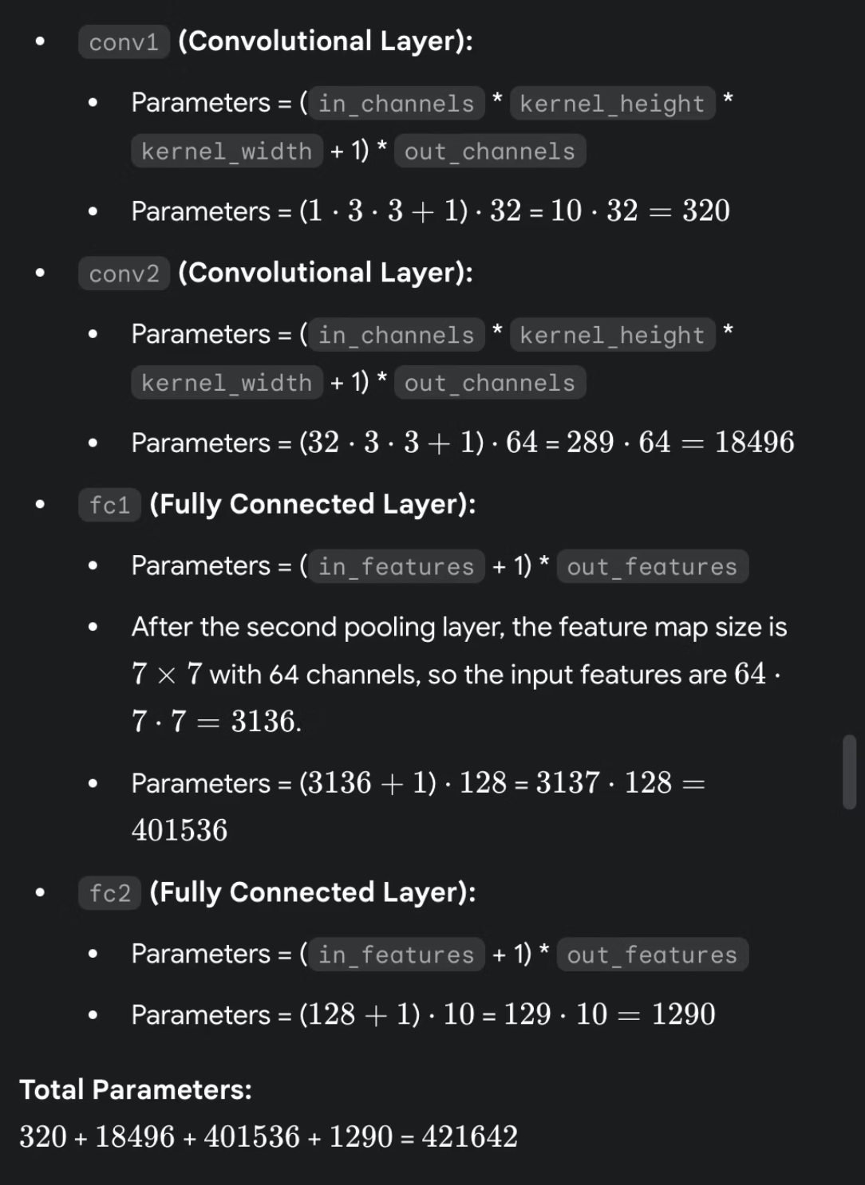
Architecture Diagram & Results
Complete federated learning system showing data flow from global server through clients with bandwidth simulation, Top-k compression, and iterative training cycles.
Model Parameters Breakdown
Final Results
Layer
Parameters
100 aggregation cycles completed successfully
conv1
320
Global model updated and verified
SHA-256 hash validation passed
conv2
18,496
Final L2 norm: 0.785988
fc1
401,536
fc2
1,290
Total
421,642

Slide 13
Performance Metrics
Latency
Throughput
Bandwidth Efficiency
Time to compute local model update + send to server
Number of successful client updates sent per unit time
Optimizations for bandwith savings: i) Sparse update (keep top 10% weights only) ii) Skipping policy (<5% threshold) prevents sending negligible updates. iii) Minimal local epochs (1 epoch)
Depends on: • Local epochs (1 epoch) • Dataset subset size • Simulated bandwidth (0.01 – 0.1 MB)
Factors: • Bandwidth threshold (e.g., 0.05) • Update size ~1.0 MB • Random client selection (bandwidth simulation)
Expected Latency per client: ~100 ms to several seconds per round
Typical throughput: 1 – 3 updates per round
Result: Fewer bytes transmitted per round Reduced communication overhead

